Slide 1


Endpoint Cyber Safeguard & Compliance
Protectit Overview

Slide 2
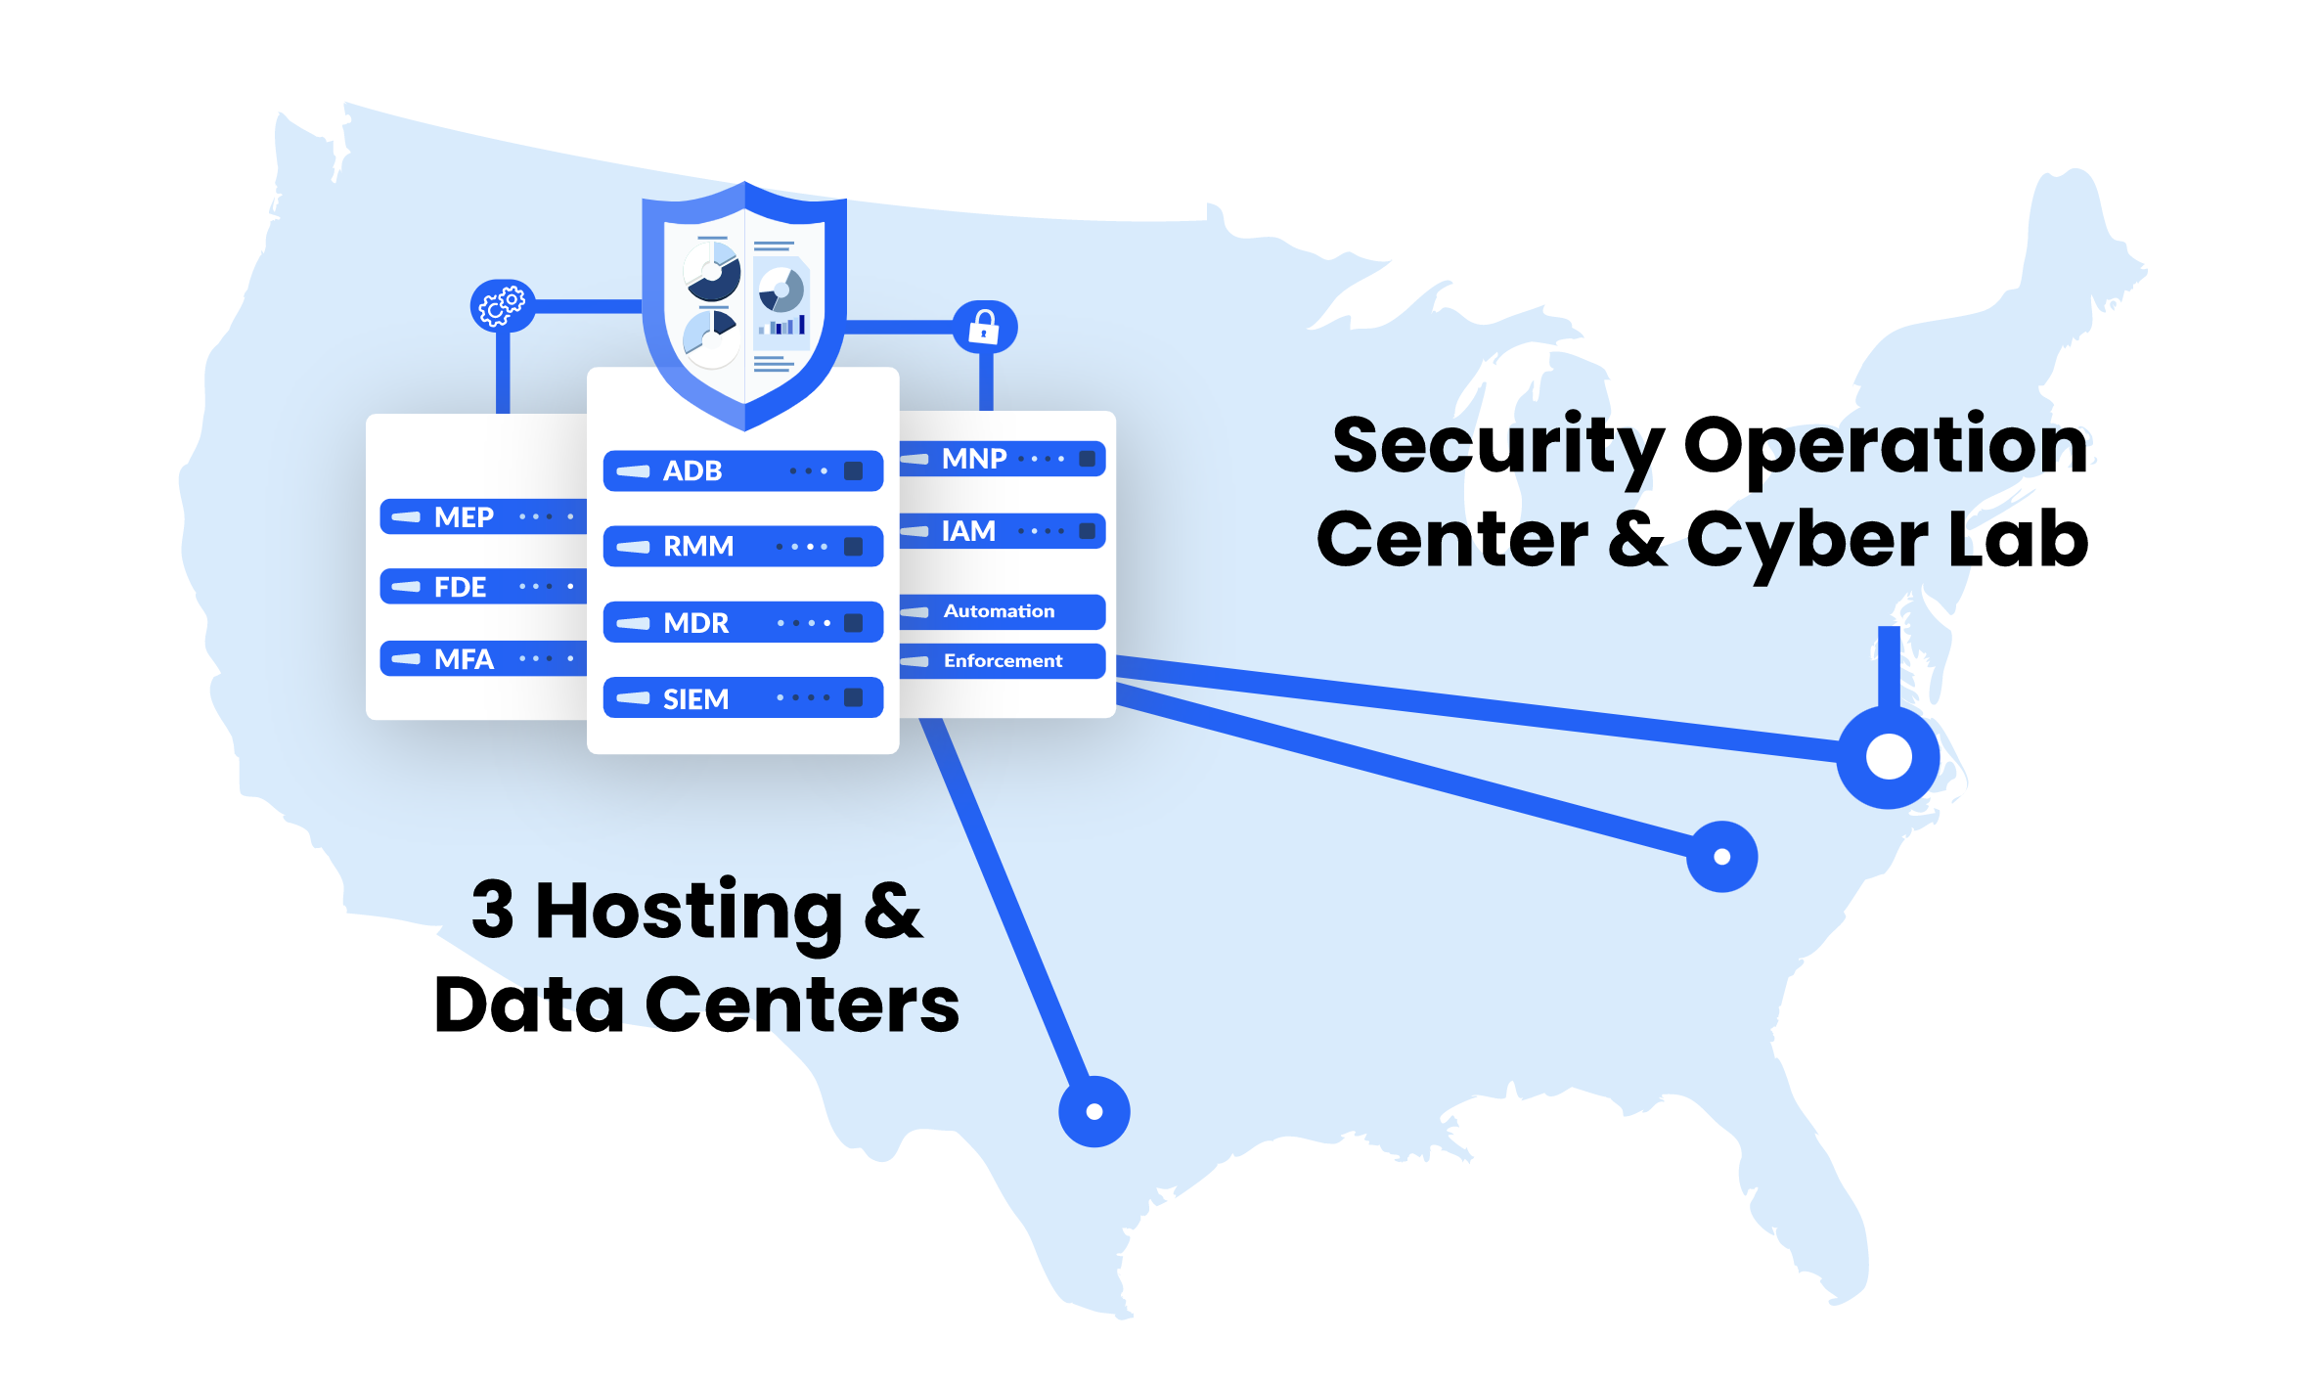

Slide 3
Steps
1. Installation
Manual Installation by Users
Silent Script
Push FCI Protectit with deployment tool (MDM, RMM, etc.)
Enterprise Detection Web Gateway
Known / unknown device check
Compliance endpoint posture check with a stop at the time of login
2. Endpoint Visibility
Actionable Dashboard
Asset Inventory Reports
3. Safeguard Enforcement
Set Cyber Settings
Install Software & Tools
Monitor & Control
Managed Endpoint Protection
3 Steps to Security & Compliance
Without the need for physically or remotely accessing Endpoints

Slide 4

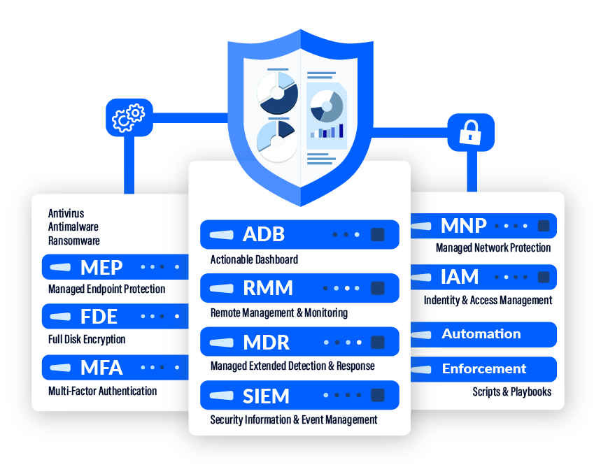
Manual Deployment
FCI adds Acme to its SOAR Platform

Slide 5




From: FCI
To: CISO
FCI Protectit Installer Link
Dear CISO,
This is the FCI Protectit installer link:
Manual Deployment
FCI sends Installer Link email to CISO
Installer Link
CISO

Slide 6


From: CISO
To: All Employees
FCI Protectit Installer Link
To all Employees,
This is the FCI Protectit installer link:
What this will do…
Manual Deployment
CISO sends Installer Link email to Employees
CISO
Installer Link
Employees

Slide 7
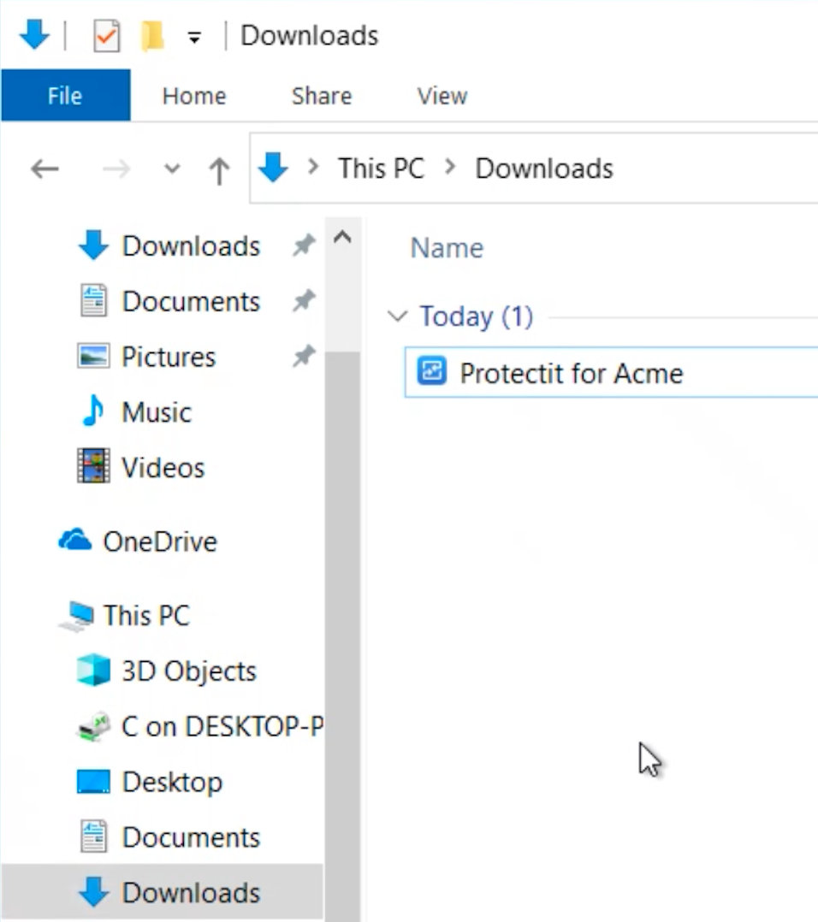


Protectit Installation
Susan downloads and runs installer
susanworksta.root.acme-corp
Susan

Slide 8
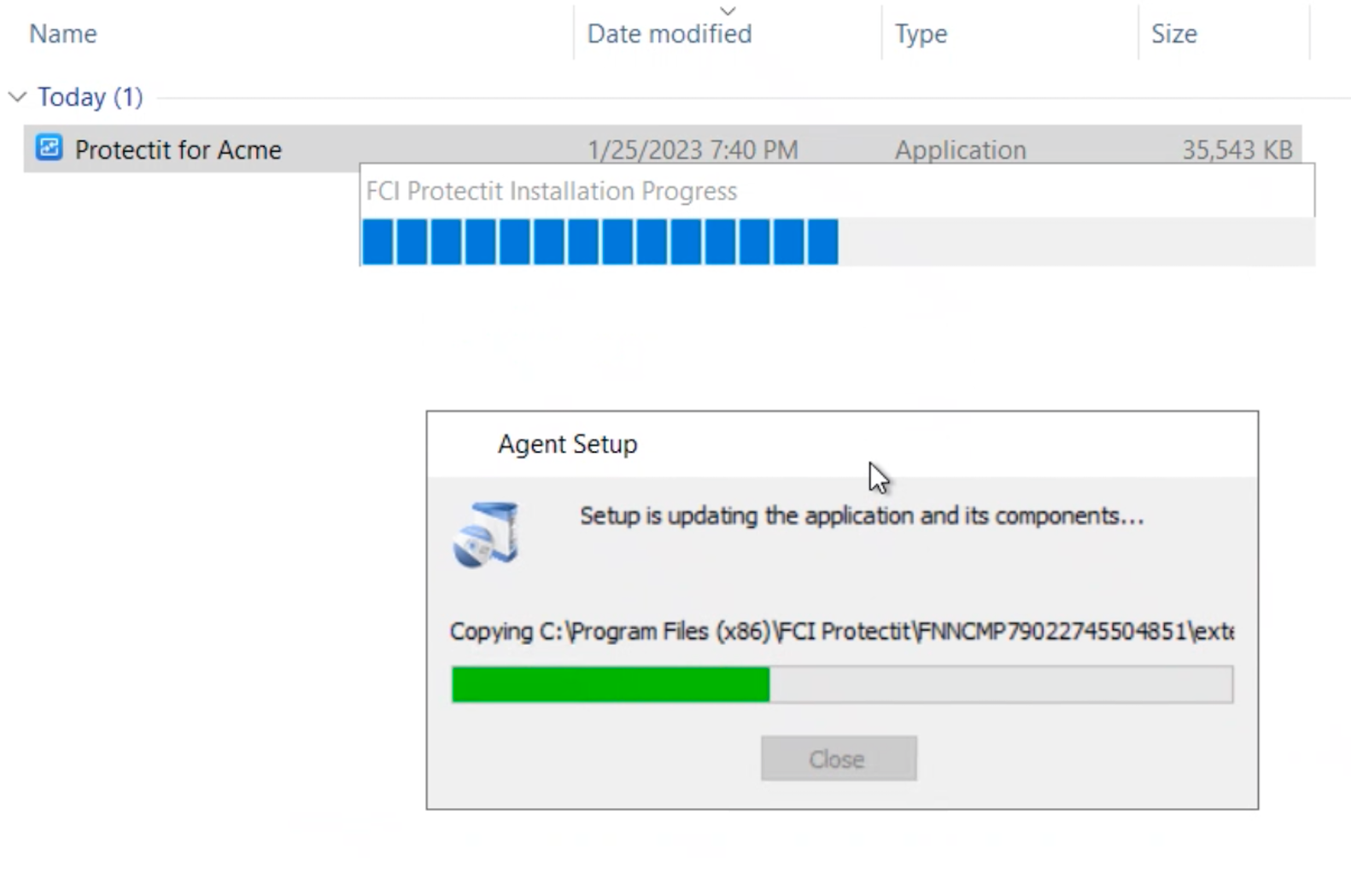
Protectit Installation
Protectit is being installed
susanworksta.root.acme-corp
Susan’s Computer

Slide 9
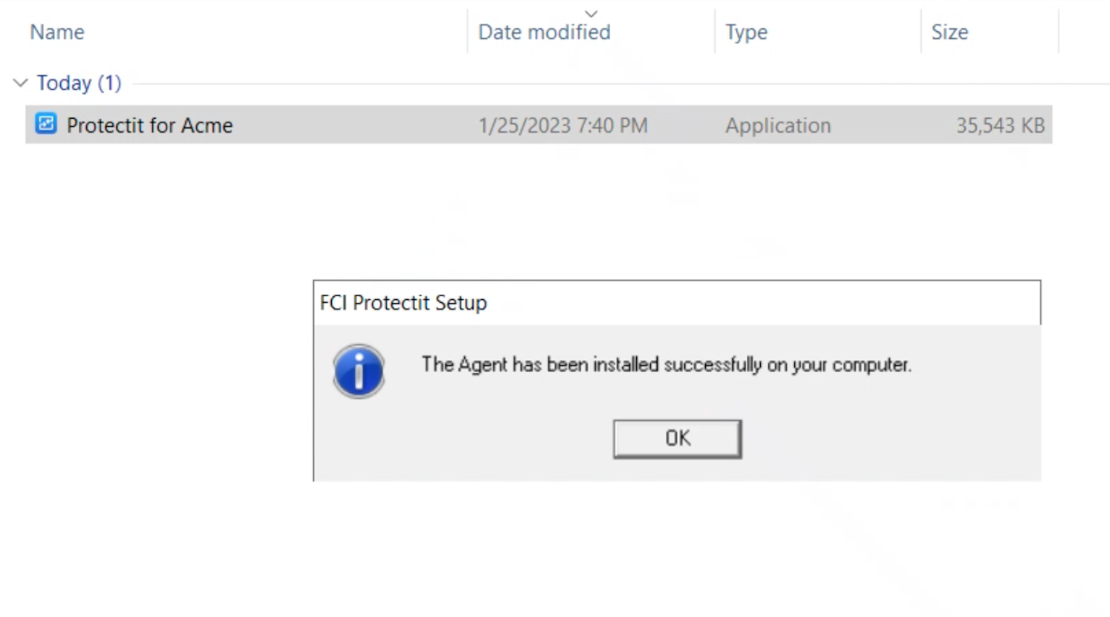
Protectit Installation
Confirmation to Susan that Protectit was installed
susanworksta.root.acme-corp
Susan’s Computer

Slide 10


Protectit Installation
Computer checks in on FCI SOAR Platform
susanworksta.root.acme-corp
TECHNICAL INFORMATION & CYBER POSTURE
Susan’s Computer

Slide 11
From: FCI
To: CISO
First Checked-In Notification
Dear CISO,
susanworksta.root.acme-corp checked in for the first time.
First Checked-In Notification
FCI sends notification to CISO
Checked-In Notification
CISO

Slide 12
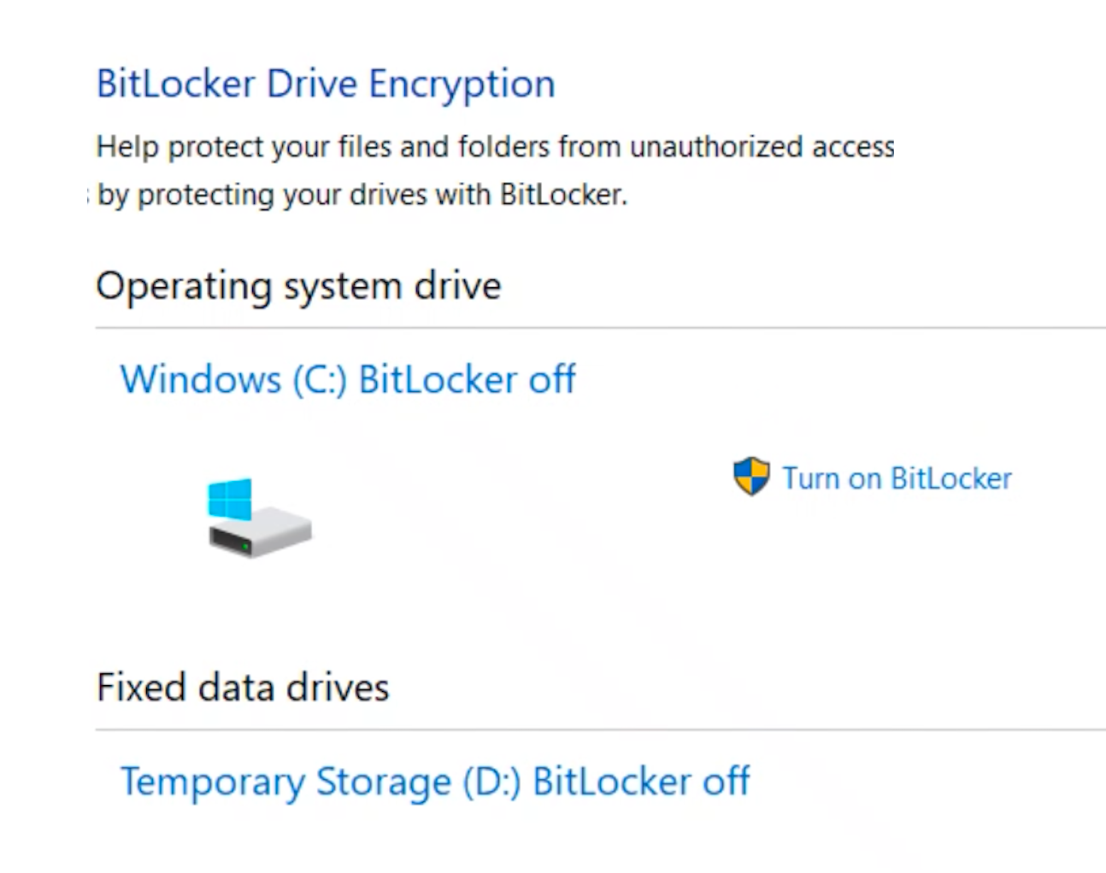
Computer Cyber Settings
Full-Disk Encryption: Off
Susan’s Computer

Slide 13
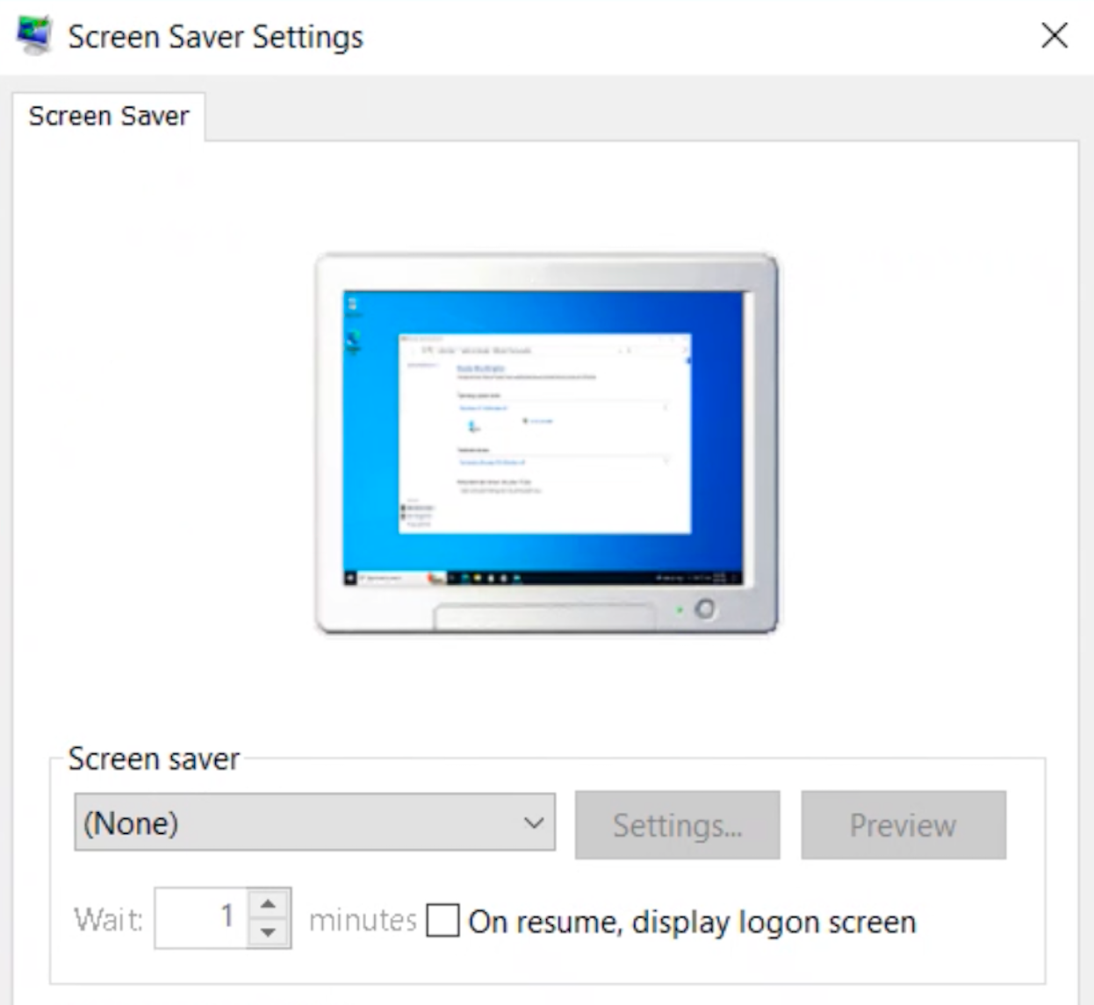
Computer Cyber Settings
Screen Saver: None
Susan’s Computer

Slide 14
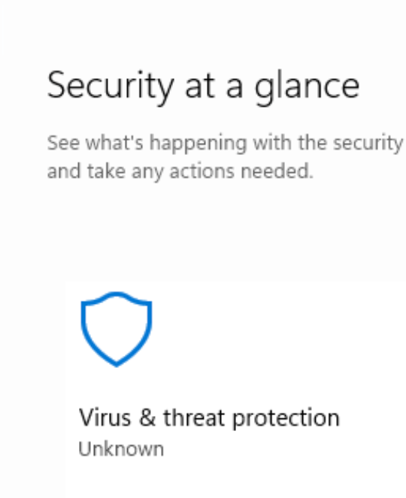
Computer Cyber Settings
Antivirus: None
Susan’s Computer

Slide 15

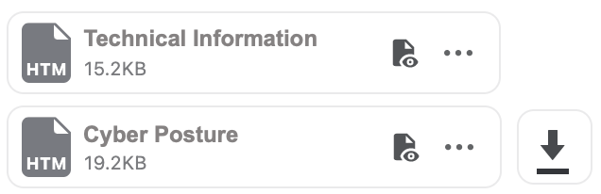
From: FCI
To: CISO
Protectit Asset Inventory Reports
Dear CISO,
Attached are your Asset Inventory Reports.
Asset Inventory
Reports
FCI sends reports to CISO
Inventory Reports
CISO

